Slide 1
AI 620 EMERGING TOPICS IN ARTIFICIAL INTELLIGENCE
Module 1
Introduction to Artificial Intelligence on AWS and Architecture Design for AI Applications

Slide 2
What is AI
AI is an umbrella term that describes a branch of computer science that aims to create intelligent agents.
The field of AI is highly technical and specialized. There is a broad set of theories, methods, and technologies in AI that allow computers to:
See (computer vision)
Hear (speech recognition)
Understand (natural language processing)
Speak (text to speech)
Think (knowledge reasoning and planning)

Slide 3
Why ai is popular
Increased volume of data
Cheaper storage
Advancements in algorithms
An increase in computing power

Slide 4
Applications of ai
Autonomous vehicles (self-driving cars)
AI in medical care
Personalized predictive keyboards
ML, NLP
RNN, LSTM

Slide 5
Why aws for ai
By far largest, most comprehensive cloud computing platform.
Offers a broad set of on-demand cloud-based services, including compute, storage, databases, networking, analytics, and much more.
For many years, developers have leveraged these services to build enterprise-grade software solutions at scale and speed that cannot be matched by any other cloud computing platform.
Offers a plethora of AI services that provide pre-trained AI capabilities, including image recognition, NLP, speech recognition and generation, and conversation agents.
Has ML services that simplify the building, training, and deployment of custom AI capabilities via ML and deep learning models.

Slide 6
More benefit of aws for ai
Combine the AWS AI and ML services with the rest of the AWS cloud computing ecosystem.
Instantly get access to an enterprise-grade cloud computing platform with a highly reliable, scalable, and secure infrastructure.
Easily collect and process large datasets so that you can integrate various AI capabilities, rapidly prototype ideas, and continuously experiment and iterate solutions.

Slide 7
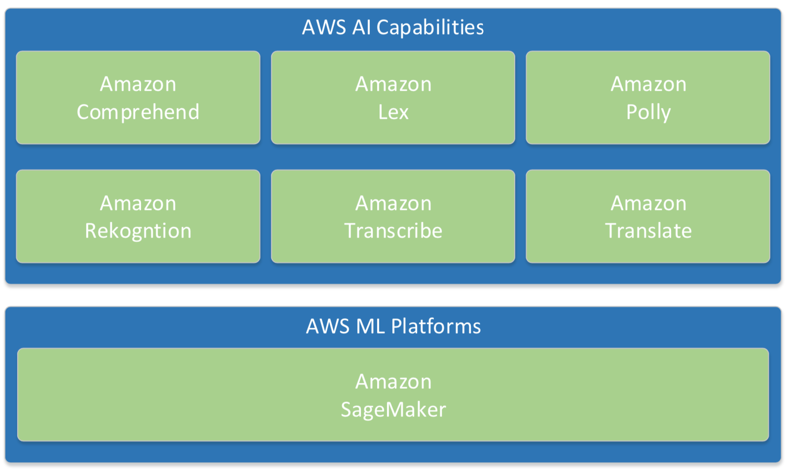
Overview of aws ai offerings

Slide 8
Aws ai capabilities
Services built on top of AWS pre-trained AI technologies.
They work right out of the box to provide ready-made intelligence for your applications.
No need to:
Understand the AI techniques that make them tick.
Maintain the infrastructure to host them.
AWS continuously improve these capabilities, your application will automatically get more intelligent without any effort on your part.

Slide 9
AWS AI capabilities
Amazon Comprehend
A NLP service that uses ML to find insights and relationships in text.
This technology allows your applications to sift through mountains of unstructured text and dig up golden nuggets of information.
Amazon Lex
A service for building conversational interfaces into applications using voice or text.
This capability is built using deep learning techniques such as automatic speech recognition (ASR) and natural language understanding (NLU) in order to convert speech into text and to recognize intents within text

Slide 10
AWS AI CAPABILITIES
Amazon Polly
A service that turns text into life-like speech that allows you to add a human voice to your application.
Amazon Rekognition
A service that can analyze images and videos in order to identify objects, people, text, scenes, and activities.
Amazon Transcribe
An ASR service that provides speech-to-text capabilities to your application.
AWS Translate
A neural machine translation service that delivers natural and fluent language translation.

Slide 11
AWS ML platforms
Fully managed infrastructures and toolsets that help developers build and run their custom AI capabilities via ML.
Provides the development constructs and handles the ML training compute resources in order to make developing custom AI capabilities easier.
AI practitioners are responsible for designing the inner workings of these AI capabilities
The collection and cleaning of training data
Selection of ML libraries and algorithms
Tuning and optimization of ML models
Designing and the development of interfaces to access the AI capabilities

Slide 12
Basic aws technology
S3
Identity and access management (IAM)
AWS CLI
AWS SDK

Slide 13
The success factors of artificial intelligence applications
Whether the application is a solution that actually solves a particular problem
What to build
How well the application is implemented to deliver the solution to the problem
How to build

Slide 14
The architecture design principles for ai applications
Should be built on top of small services with focused business capabilities.
These small services are much easier to implement, test, and deploy.
A good application architecture should have well-defined boundaries to enforce separation of concerns.
The services and components of the application should maintain this separation by hiding internal implementation details from the others.
This separation allows services and components to be replaceable with minimal impact on the rest of application.

Slide 15
The architecture of modern applications
User interfaces
Orchestration layer
Private APIs
Vendor/custom services

Slide 16
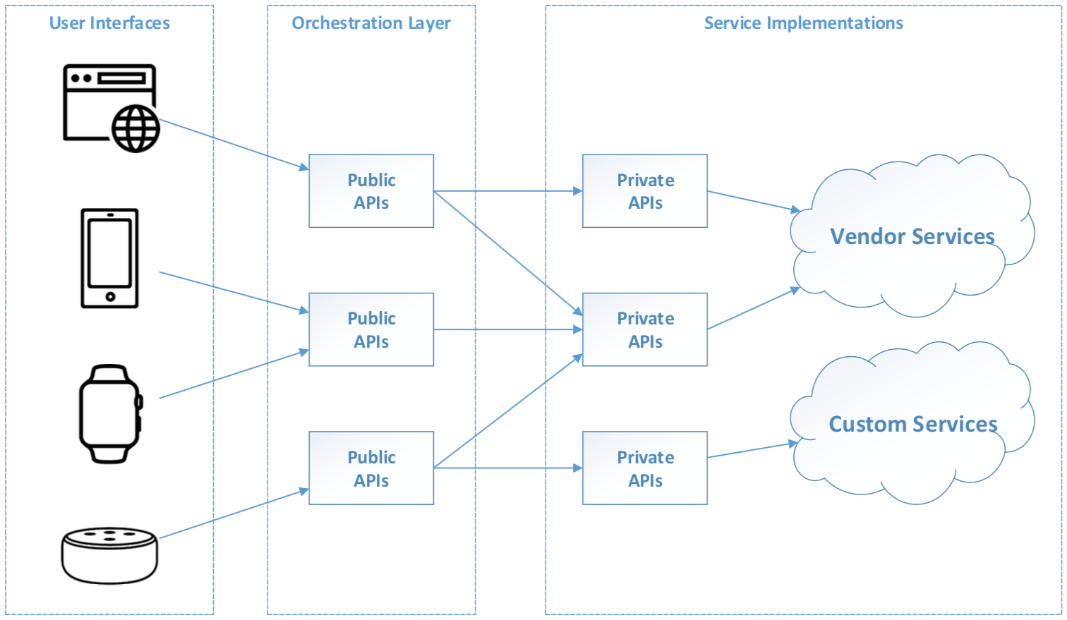
ORGANIZATION OF BASIC ARCHITECTURE COMPONENTS AND LAYERS

Slide 17
Clean architecture
Keep these components separated
The user interfaces should only know about the public APIs in the orchestration layer.
The public APIs should only know about the private APIs that they depend on.
The private APIs should only know about the service implementations they wrap around.
This is the principle of information hiding, which is applied at the architecture level.

Slide 18
Creation of custom AI capabilities
The AI application development life cycle
The AI capability development life cycle

Slide 19
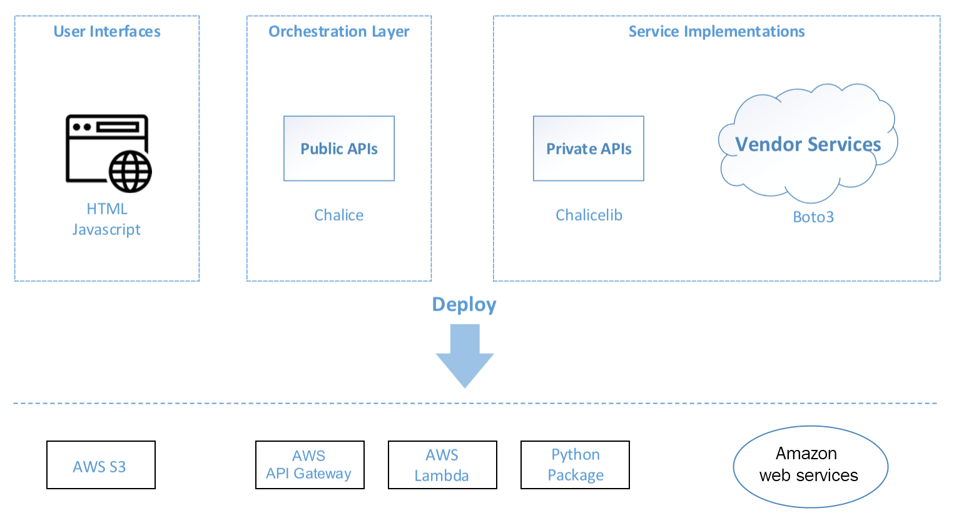
Working with a hand-on ai application architecture

Slide 20
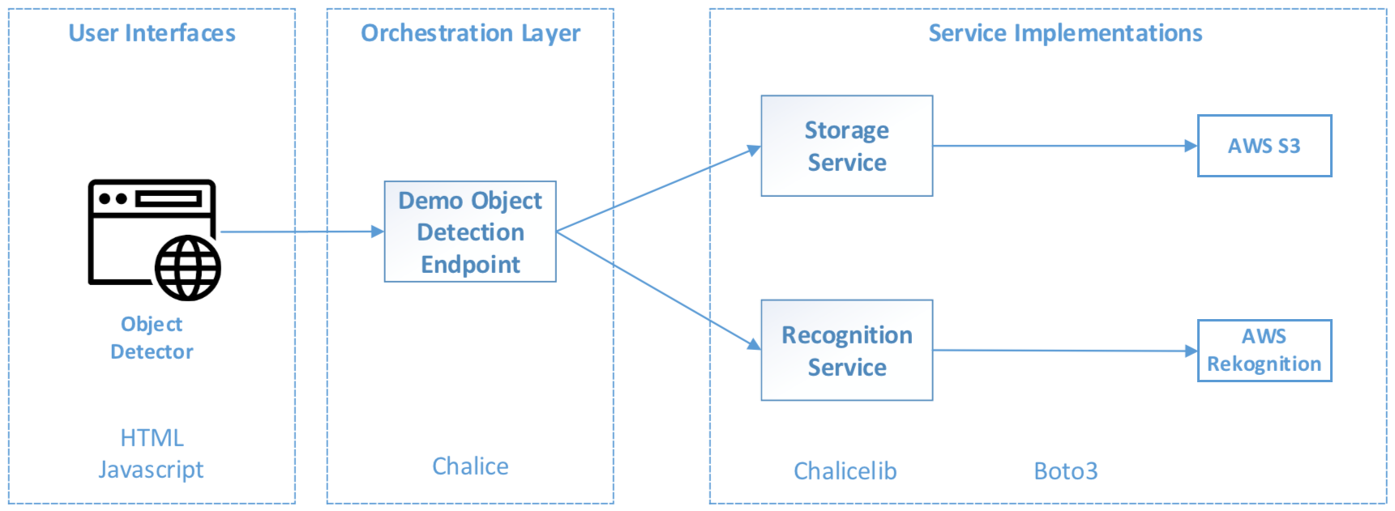
Object detector architecture

Slide 21
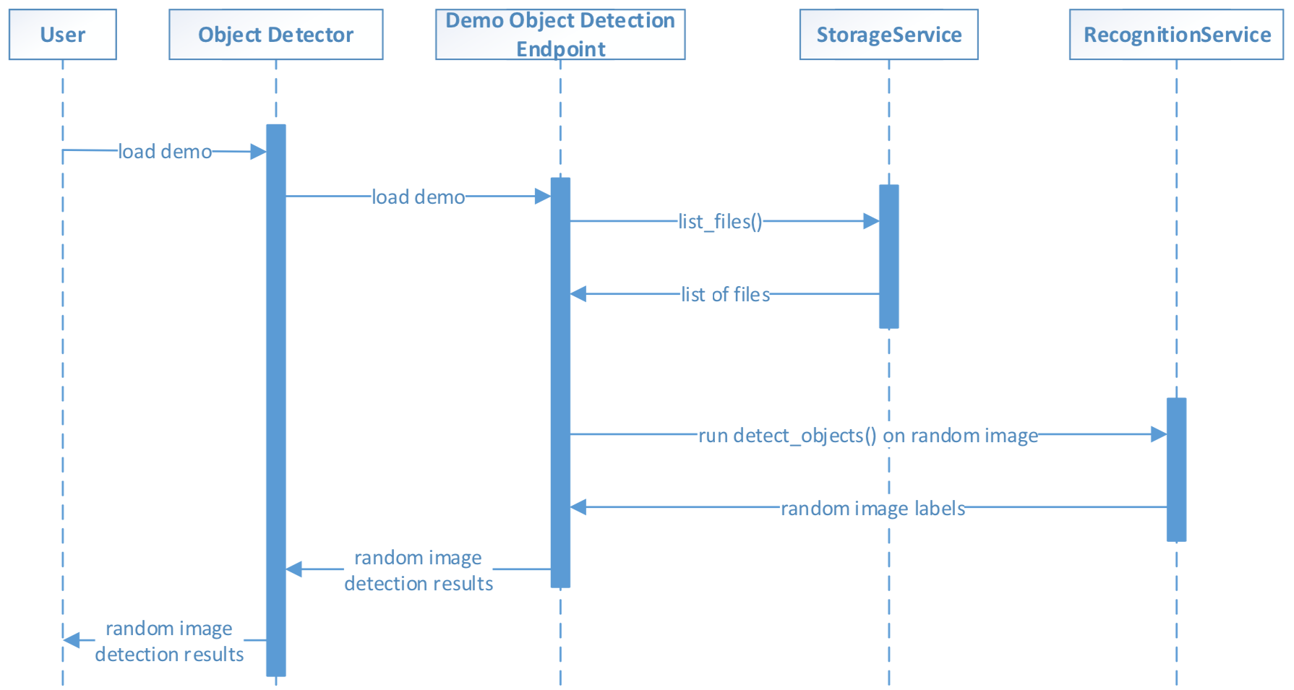
Component interactions of the object detector

Slide 22
References
Tripuraneni, S., & Song, C. (2019). Hands-On Artificial Intelligence on Amazon Web Services. Packt Publishing. https://learning.oreilly.com/library/view/hands-on-artificial-intelligence/9781789534146/

